Slide 1

Self Service Stories
JPMorgan Chase
Code for Good - Houston 2017
Team 4
Batu Balimtas
Nikhil Palvai
Chris Fitzmorris
Puneeth Bikkumanla
Dana Seibert

Slide 2
Current Problems
Communication
Obsolete and slow system
Tracking volunteers
Logging hours manually, inaccurate, no shows
Event System
Planning events, organizing volunteers and materials
Awareness
Low coverage and storytelling

Slide 3
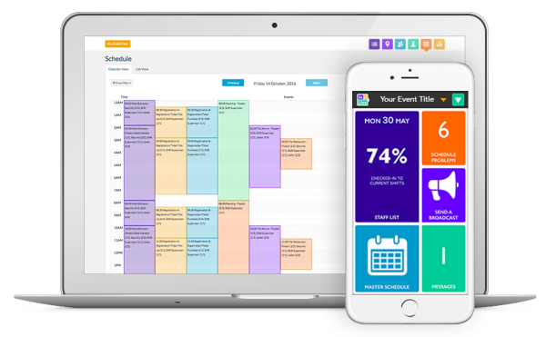
Existing Solutions
Scheduling
Communication
Event Day App
Reporting

Slide 4
Our Thoughts
01
Rework Existing Solution?
Build Unique Technology?
02

Slide 5
Awareness
↑ 4,819 ↑
549
↓ 57% ↓
Reduction in overall
homelessness since 2011
SEARCH clients
increased
their income.
Veterans housed since 2012

Slide 6



Cross Platform Application
Stories
Platform for stories to be told
Self Service
Reduce administrative overhead
Sharing
Facebook, Twitter, Google, etc.
Impact
Recognize contributions over time and their effects

